Slide 1
String Class

Slide 2
Java String
Basically, string is a sequence of characters but it's not a primitive type.
When we create a string in java, it actually creates an object of type String.
String is immutable object which means that it cannot be changed once it is created.
String is the only class where operator overloading is supported in java.

Slide 3
Identifying problems that can occur when you manipulate string data
String is not a simple data type like int, float, or double
String creates an instance of a class, the class String
As such it contains a reference or an address and not the actual string
So you cannot do equality comparisons of two different instances of String, because you are simply testing if the addresses are the same

Slide 4
How to create a string object?
There are two ways to create String object:
By string literal
By new keyword
char[] ch={'j','a','v','a','t','p','o','i','n','t'};
String s=new String(ch); //By new object
is same as:
String s="javatpoint"; //string literal

Slide 5
An example of incorrect code
import javax.swing.JOptionPane;
public class TryToCompareStrings
{
public static void main(String[] args)
{
String aName = “Mahesh";
String anotherName;
anotherName = JOptionPane.showInputDialog(null,
"Enter your name");
if(aName == anotherName)
JOptionPane.showMessageDialog(null, aName +
" equals " + anotherName);
else
JOptionPane.showMessageDialog(null, aName +
" does not equal " + anotherName);
System.exit(0);
}
}

Slide 6
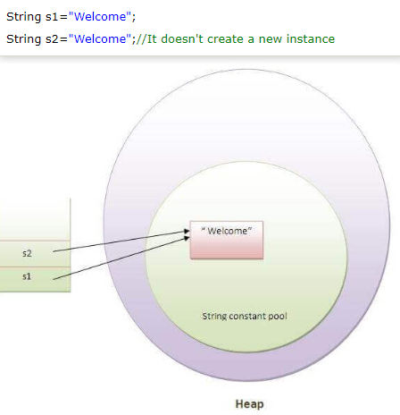
In the this example, only one object will be created.
Firstly, JVM will not find any string object with the value "Welcome" in string constant pool, that is why it will create a new object.
After that it will find the string with the value "Welcome" in the pool, it will not create a new object but will return the reference to the same instance.
Note: String objects are stored in a special memory area known as the "string constant pool".

Slide 7
Immutable String in Java
In java, string objects are immutable.
Immutable simply means unmodifiable or unchangeable.
Once string object is created its data or state can't be changed but a new string object is created.

Slide 8
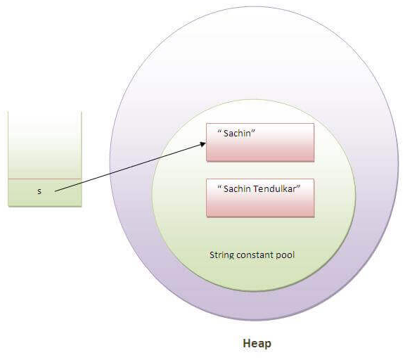
Here Sachin is not changed but a new object is created with
Sachin Tendulkar.
That is why string is known as immutable.

Slide 9
Concatenation with +
class StringConcatenation2
{
public static void main(String args[])
{
String s=50-30*2+"KMIT"+40+40+40;
System.out.println(s);
String s=50+30+2+"KMIT"+40+40+40;
}
}
//-10KMIT4040
Note: After a string literal, all the + will be treated as string concatenation operator.

Slide 10
Concatenation with +
class StringConcatenation2
{
public static void main(String args[])
{
String s=50+30*2+"KMIT"+40-40/40;
System.out.println(s);//
}
}

Slide 11
Immutable String in Java
class TestImmutableString
{
public static void main(String args[])
{
String s="Virat";
s=s.concat(" Kohli");//concat() method appends the string at the end
System.out.println(s);//will print Virat because strings are immutable objects
}
}
In such case, s points to the “Virat Kohli". Please notice that still sachin object is not modified.

Slide 12
class Teststringcomparison3
{
public static void main(String args[]){
String s1="Virat";
String s2="Virat";
String s3=new String("Virat");
System.out.println(s1==s2);//true (because both refer to same instance)
System.out.println(s1==s3);//false(because s3 refers to instance created in nonpool)
}
}

Slide 13
String Functions
charAt()
charAt() function returns the character located at the specified index.
String str = "studytonight"; System.out.println(str.charAt(2));
Output: u
NOTE: Index of a String starts from 0, hence str.charAt(2) means third character of the String str.

Slide 14
String Functions
equalsIgnoreCase()
equalsIgnoreCase() determines the equality of two Strings, ignoring their case (upper or lower case doesn't matters with this fuction ).
String str = "java"; System.out.println(str.equalsIgnoreCase("JAVA"));
Output
true

Slide 15
String Functions
indexOf()
indexOf() function returns the index of first occurrence of a substring or a character. indexOf() method has four forms:
int indexOf(String str): It returns the index within this string of the first occurrence of the specified substring.
int indexOf(char ch, int fromIndex): It returns the index within this string of the first occurrence of the specified character, starting the search at the specified index.
int indexOf(char ch): It returns the index within this string of the first occurrence of the specified character.
int indexOf(String str, int fromIndex): It returns the index within this string of the first occurrence of the specified substring, starting at the specified index.

Slide 16
String Functions
class IndexOf
{
public static void main(String[] args)
{
String str="StudyTonight";
String subString="Ton";
System.out.println(str.indexOf(subString)); // 1st form: op 5
System.out.println(str.indexOf('t', 3)); //2nd form: op 11
System.out.println(str.indexOf('u')); //3rd form: op 2
System.out.println(str.indexOf(subString,7)); //4th ’Tom’ not found after 7 op -1
}
}
5
11
2
-1

Slide 17
For interactive i/p & o/p
import javax.swing.*;
String name;
name = JOptionPane.showInputDialog( null, “Enter Roll No");
String firstName = “Kumar”
JOptionPane.showMessageDialog(null, "Dear " + firstName )

Slide 18
Ex
Wjp to enter a string using
JOptionPane.showInputDialog to display a message “Add Hello and 2 words” store the string in an object.
Write code to find whether "Hello“ is a part of the entered string or not.
If not found display “Hello not found “
Otherwise “Found Hello at index “ x

Slide 19
String Functions
import javax.swing.*;
public class SearchWord
{
public static void main(String[] args)
{
String strOrig ;
strOrig = JOptionPane.showInputDialog( null, "Add Hello and 2 words");
int intIndex = strOrig.indexOf("Hello");
if(intIndex == - 1)
System.out.println("not found Hello ");
else
System.out.println("Found Hello at index "+ intIndex);
}
}

Slide 20
String Functions
length()
length() function returns the number of characters in a String.
String str = "Count me"; System.out.println(str.length());
Output
8

Slide 21
String Functions
substring()
substring() method returns a part of the string. substring() method has two forms,
public String substring(int begin);
public String substring(int begin, int end);
/* character of begin index is inclusive and character of end index is exclusive. */The first argument represents the starting point of the subtring. If the substring() method is called with only one argument, the subtring returned, will contain characters from specified starting point to the end of original string.
But, if the call to substring() method has two arguments, the second argument specify the end point of substring.
String str = "0123456789"; System.out.println(str.substring(4));456789
System.out.println(str.substring(4,7));456

Slide 22
String Functions
replace()
replace() method replaces occurances of character with a specified new character.
String str = "Change me"; System.out.println(str.replace('m','M'));
Output
Change Me

Slide 23
Ex
Using JOptionPane.showInputDialog method take First and Last name of the customer. (Ram Singh)
Using JOptionPane.showMessageDialog method display the message
Dear Ram
I am so glad we are on first name basis
I want to invite the entire Singh
family for party today.
Please confirm at 9888776655.

Slide 24
String Functions
import javax.swing.*;
public class BusinessLetter
{
public static void main(String[] args)
{
String name;
String firstName = "";
String familyName = "";
int x;
char c;
name = JOptionPane.showInputDialog(null,
"Please enter customer's first and last name");
x = 0;
while(x < name.length())
{
if(name.charAt(x) == ' ')
{
firstName = name.substring(0, x);
familyName = name.substring(x + 1, name.length());
x = name.length();
}
++x;
}
JOptionPane.showMessageDialog(null,
"Dear " + firstName +
",\nI am so glad we are on a first name basis" +
"\nI want to invite the entire " + familyName +
"\nfamily for party today." +
"\nPlease confirm at 9888776655.");
System.exit(0);
}
}

Slide 25
String Functions
toLowerCase()
toLowerCase() method returns string with all uppercase characters converted to lowercase.
String str = "ABCDEF"; System.out.println(str.toLowerCase());
Output:
abcdef

Slide 26
String Functions
toUpperCase()
This method returns string with all lowercase character changed to uppercase.
String str = "abcdef"; System.out.println(str.toUpperCase());
Output:
ABCDEF

Slide 27
The equals() method
From the code above, we can see that the equals() method returns a Boolean value of true or false
String aName = “Ravi”;
String bName = “ravi”;
if(aName.equals(bName))

Slide 28
Comparing String Values
The String class provides methods for comparing strings
In the example above the == sign is comparing memory addresses, not the actual strings.
The String class equals() method evaluates the contents of two String objects to determine if they are equivalent.

Slide 29
Comparing String Values
Consider the following two statements:
String aGreeting = “hello”;
aGreeting = “Bonjour”;
These statements are syntactically correct.
What happens is that the address contained in aGreeting is changed to point to “Bonjour” rather than “hello”,
both of which are contained at different locations in memory.
Eventually, the garbage collector discards the “hello” characters.

Slide 30
import javax.swing.*;
public class EqualsExample
{
public static void main(String[] args)
{
String aName = "Ravi", anotherName;
anotherName = JOptionPane.showInputDialog(null, "Enter your name");
if(aName.equals(anotherName))
JOptionPane.showMessageDialog(null,aName + " equals " + anotherName);
else
JOptionPane.showMessageDialog(null, aName + " does not equal " + anotherName);
System.exit(0);
}
}

Slide 31
equalsIgnoreCase() Method
Similar to the equals() method
Ignores case
String aName = “Keshav”;
If(aName.equalsIgnoreCase(“KesHAV”))…
evaluates to true

Slide 32
String Functions
valueOf()
Overloaded version of valueOf() method is present in String class for all primitive data types and for type Object.
NOTE: valueOf() function is used to convert primitive data types into Strings.
class Example
{
public static void main(String args[])
{
int num = 35;
String s1 = String.valueOf(num); //converting int to String
System.out.println(s1+"IAmAString");
}
}

Slide 33
String Functions
But for objects, valueOf() method calls toString() function.

Slide 34
String Functions
toString()
toString() method returns the string representation of the object used to invoke this method. toString() is used to represent any Java Object into a meaningful string representation. It is declared in the Object class, hence can be overrided by any java class. (Object class is super class of all java classes.)
class Car
{
public static void main(String args[])
{
Car c = new Car();
System.out.println(c);
}
public String toString()
{
return "This is my car object";
}
}

Slide 35
String Functions
Whenever we will try to print any object of class Car, its toString() function will be called. toString() can also be used with normal string objects.
String str = "Hello World"; System.out.println(str.toString());
If we don't override the toString() method and directly print the object, then it would print the object id.
Example:

Slide 36
String Functions
class Car {
public static void main(String args[])
{
Car c = new Car();
System.out.println(c);
}
}
Car@52e922

Slide 37
String Functions
toString() with Concatenation
Whenever we concatenate any other primitive data type, or object of other classes with a String object,
toString() function or
valueOf() function
is called automatically to change the other object or primitive type into string, for successful concatenation.
int age = 10;
String str = "He is" + age + "years old.";
In above case 10 will be automatically converted into string for concatenation using valueOf() function.

Slide 38
String Functions
trim()
This method returns a string from which any leading and trailing whitespaces has been removed.
String str = “ hello "; System.out.println(str.trim());
Output:
hello
NOTE: If the whitespaces are between the string, for example: String s1 = "study tonight “ ;
then System.out.println(s1.trim());
will output "study tonight".
trim() method removes only the leading and trailing whitespaces.

Slide 39
StringBuffer class
StringBuffer class is used to create a mutable string object i.e its state can be changed after it is created. It represents growable and writable character sequence. As we know that String objects are immutable, so if we do a lot of changes with String objects, we will end up with a lot of memory leak.
So StringBuffer class is used when we have to make lot of modifications to our string. It is also thread safe i.e multiple threads cannot access it simultaneously. StringBuffer defines 4 constructors. They are,
StringBuffer ( )
StringBuffer ( int size )
StringBuffer ( String str )
StringBuffer ( charSequence [ ]ch )
StringBuffer() creates an empty string buffer and reserves room for 16 characters.
stringBuffer(int size) creates an empty string and takes an integer argument to set capacity of the buffer.

Slide 40
String Functions
class Car
{
public static void main(String args[])
{
String str = "study";
str.concat("tonight");
System.out.println(str); // Output: study
StringBuffer strB = new StringBuffer("study");
strB.append("tonight");
System.out.println(strB); // Output: studytonight
}
}

Slide 41
String Functions
Reason:
Output is such because String objects are immutable objects.
Hence, if we concatenate on the same String object, it won't be altered
Output: study
But StringBuffer creates mutable objects. Hence, it can be altered.
Output:
studytonight

Slide 42
Important methods of StringBuffer class
append()
This method will concatenate the string representation of any type of data to the end of the invoking StringBuffer object. append() method has several overloaded forms.

Slide 43
String Functions
StringBuffer append(String str)
StringBuffer append(int n)
StringBuffer append(Object obj)
The string representation of each parameter is appended to StringBuffer object.
StringBuffer str = new StringBuffer("test");
str.append(123);
System.out.println(str);
Output:
test123

Slide 44
String Functions

